Slide 1

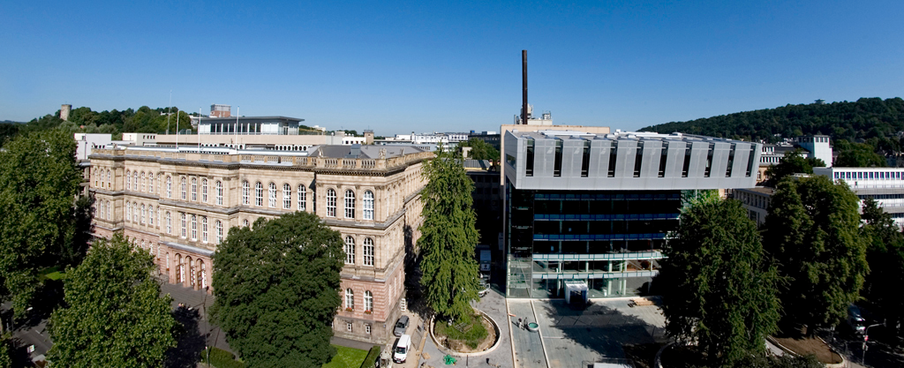
AixSense Team
SensUs 2018
Supervisor: Dr. Sven Ingebrandt

Slide 2
Outline
Team Introduction
Logistics & resources
Design Breakdown
2 von 20

Slide 3
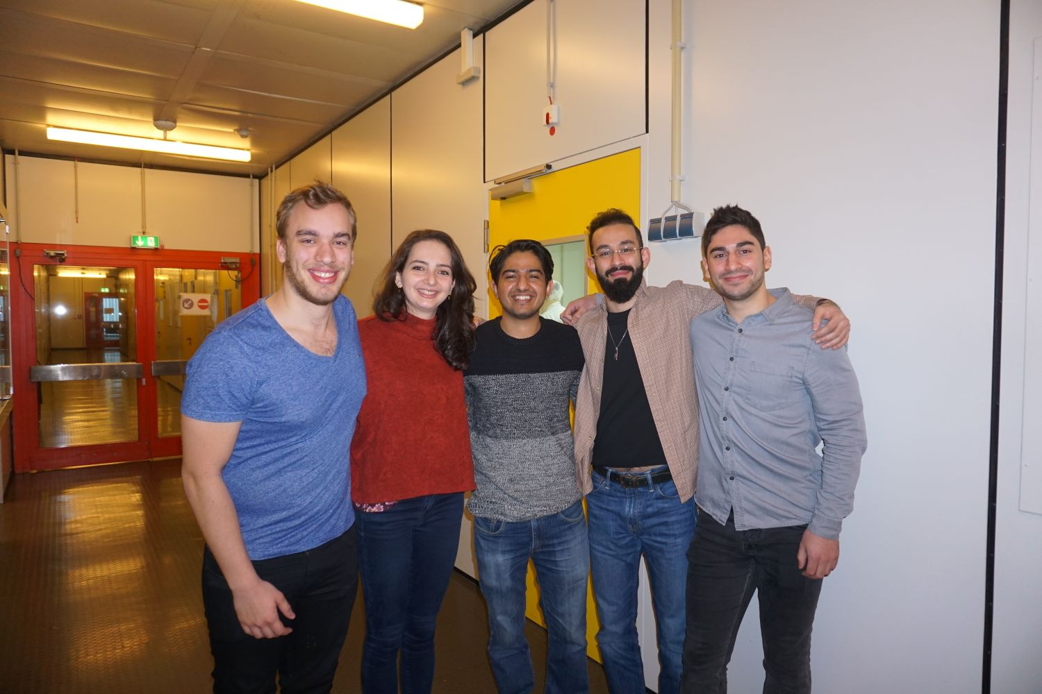
Team Introduction
Paula Estrella Palacios Mahave
Firas Khader
Alexander Joachim Grade
Mohit Mukund Suranglikar
Parham Mohajerani

Slide 4
Logistics & resources
In collaboration with faculty of Eletrotechnik and informationtechnik
Granted:
Labs and clean room access
Access to equipment and necessary training
Seminar rooms for regular team meeting
Faculty and University Library
Supervision and mentoring
Supervisor: Dr. Sven Ingebrandt
Mentors: Stefanie Wiedemann, Vivek Pachauri

Slide 5
Design Breakdown
First Meeting Jan 31. 2018
Preliminary Team Expertise breakdown
Possible design requirements
Sensor, and Microcontroller Control loop
Circuit Design
Clean Room
Chip Encapsulation
Micro and Bio-fluid processing
Team Management breakdown

Slide 6
Future Tasks
Tasks currently in team Agenda
Further Design Development and project identification
Team management and task distribution
Additional Member Requirement

